Slide 1
Cap 806 PHOTOSHOP
Lecture #0
The kick start session

Slide 2
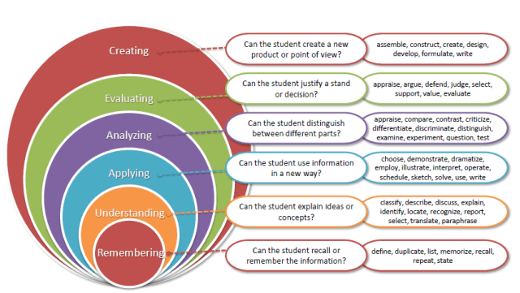
Revised Bloom’s Taxonomy

Slide 3
Program Outcomes
PO1 : Analysis & design of complex problems : Ability to apply knowledge of computer science concepts, principles & techniques to solve various computing problems.
PO2 : Societal Impact : Acquire and apply advanced knowledge of concepts and participate in sustainable development.
PO3 : Modern tool usage : Ability to use the modern programming languages, tools, techniques and skills necessary for design, develop and deploy software based applications.
PO4 : Domain Knowledge : Ability to apply exploration to study and analyze problems in different areas of information technology.
PO5 : Professionalism : Ability to Manage time well, demonstrate an appropriate level of preparedness and maintain a high standard for personal and professional demeanor, accepting responsibility and accountability for words and actions
PO6 : Research Problem Solving : Ability to assimilate, evaluate and present research results objectively
PO7 : Employability : Ability to get employment opportunities in corporate/government/private sectors or to be a successful entrepreneur

Slide 4
Course Outcomes
CO1:::apply masking techniques to hide or reveal portions of layers in an image
CO2::: analyze different layers of images and work with them for creating animations
CO3::construct the images by using various color modes
CO4::: develop images in Photoshop GUI from start to end.

Slide 5
Course Details
LTP – 0 0 3 [Three Practicals/week]
Text Book
PHOTOSHOP CS6 UNLOCKED, 2/ED 101 TIPS, TRICKS & TECHNIQUES

Slide 6
Course Assessment Model
Marks break up
Attendance 5
CA (2 best out of 3) 45
ETE 50
Total 100

Slide 7
Acknowledgements
The Khan Academy
EdX
Coursera
adobe.com
Photoshopessentials.com
Above all…

Slide 8
The course contents
Getting started with Photoshop
Working with Layers
Working with Selections
Accessing basic tools
Working with blending options.
Masking
Working with adjustment Layer

Slide 9
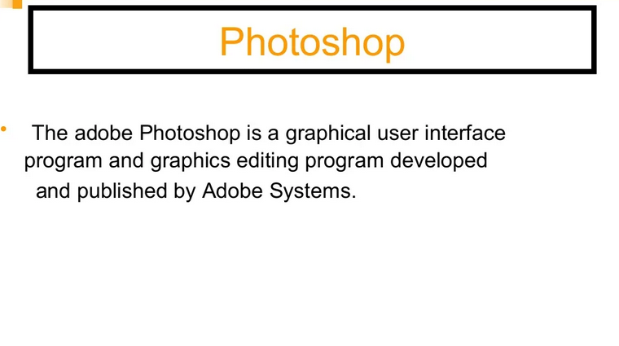

Slide 10
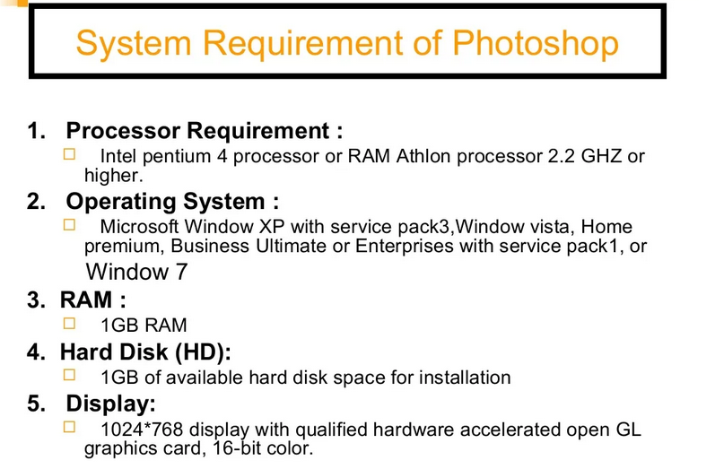

Slide 11
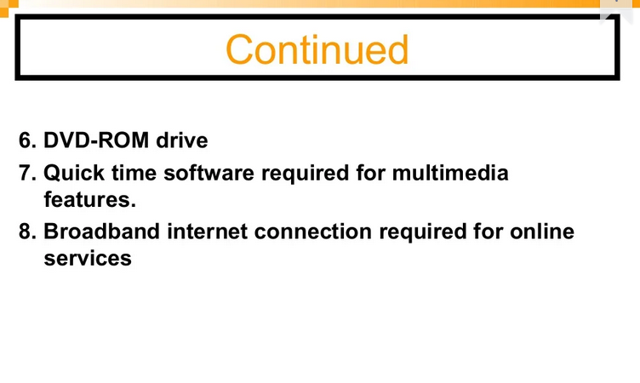

Slide 12
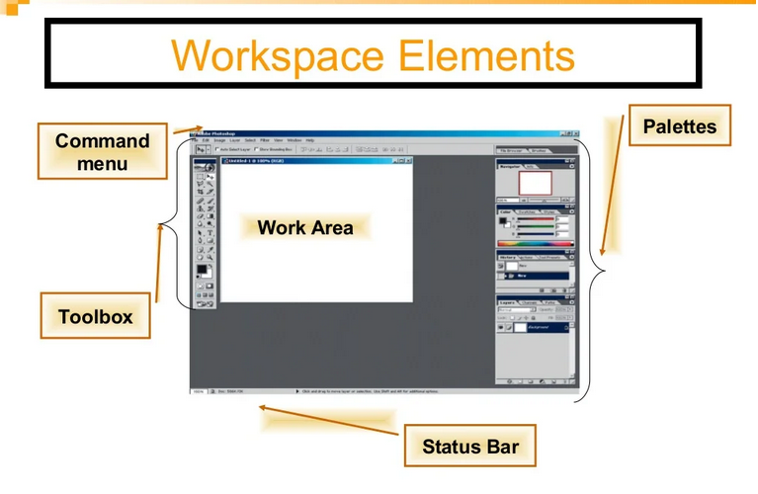

Slide 13
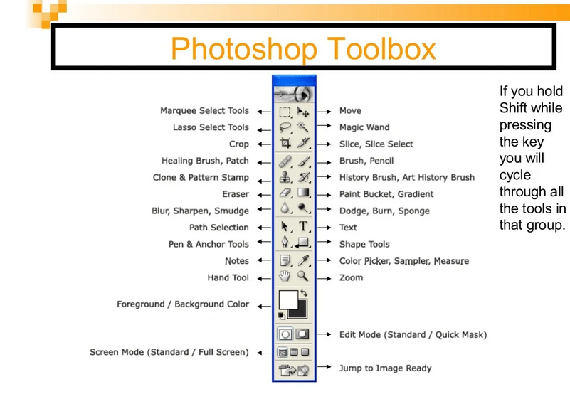

Slide 14
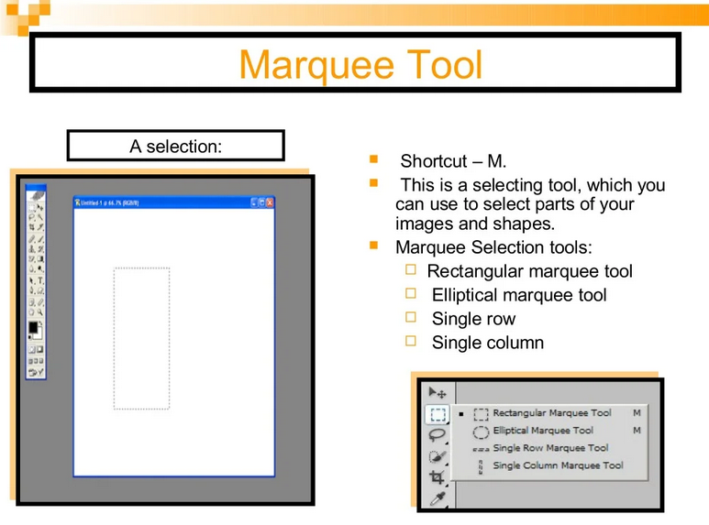

Slide 15
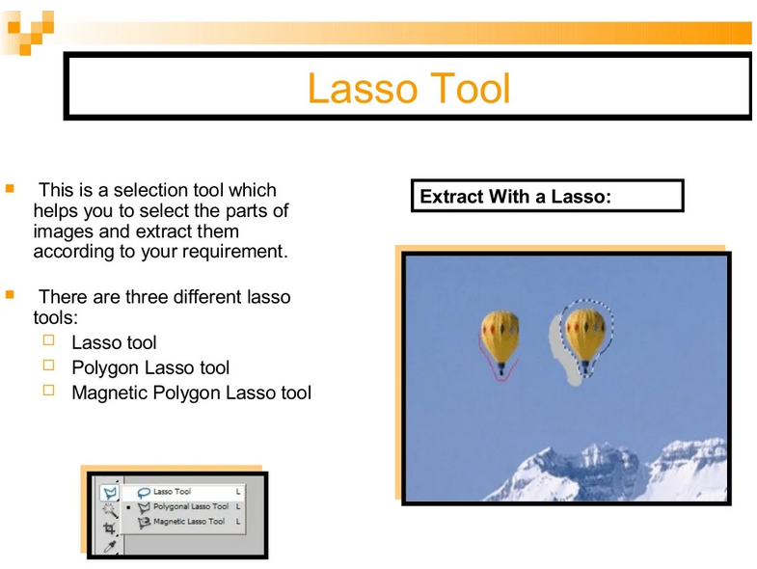

Slide 16
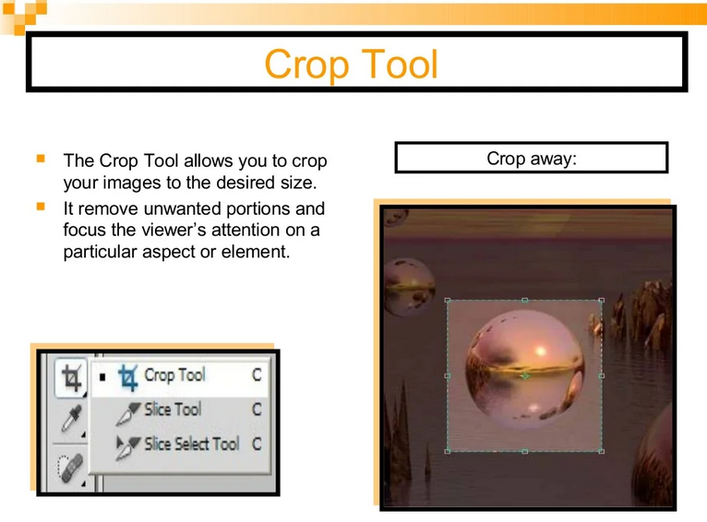

Slide 17
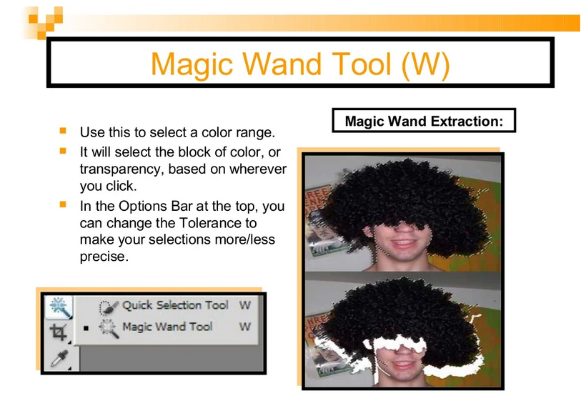

Slide 18
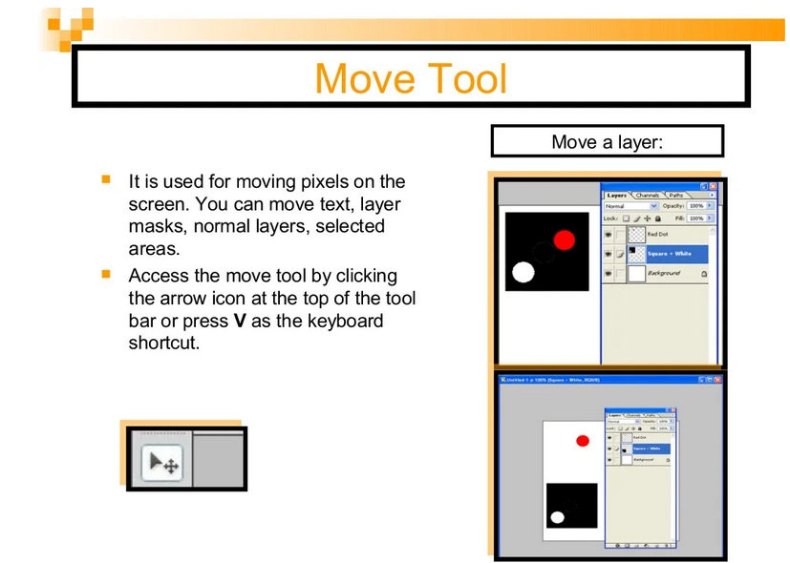

Slide 19
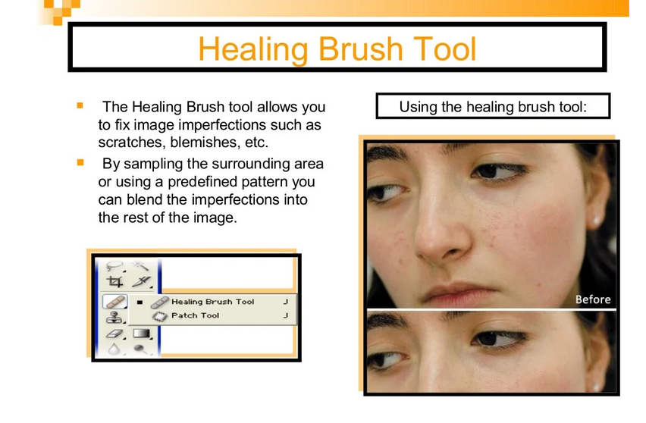

Slide 20
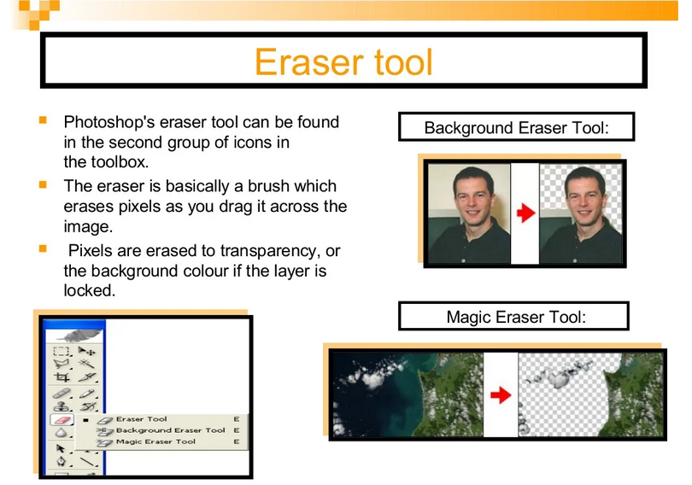

Slide 21
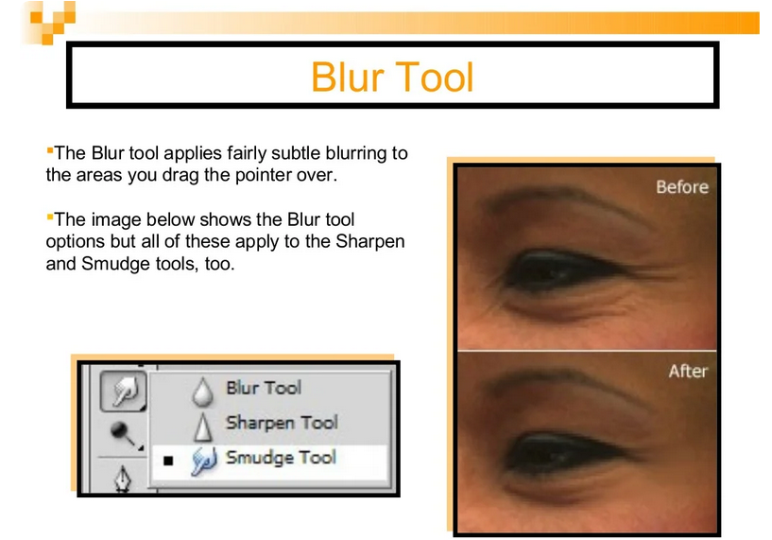

Slide 22
